Slide 1
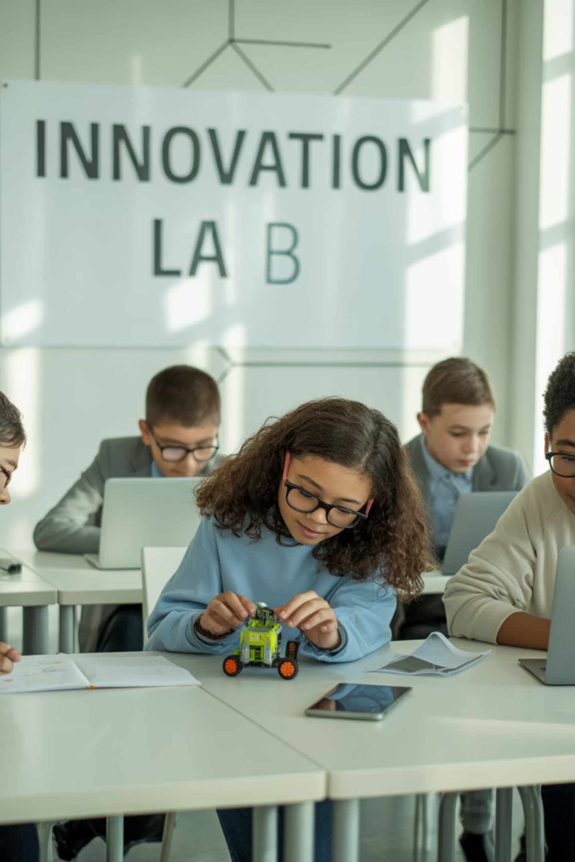
Machine Learning:
Four types of learning
How do computers learn like humans?
Machine learning means teaching computers to learn from data and make decisions without being told every step. It's like how you learn from examples and practice - computers can get smarter too!

Slide 2
The 4 Types of Machine Learning You Should Know
Supervised Learning
Unsupervised Learning
Learning with a teacher
Finding patterns alone
Reinforcement Learning
Evolutionary Learning
Learning by rewards
Learning like nature
Let's explore each one with fun examples that show how computers can be just as curious as you are!

Slide 3
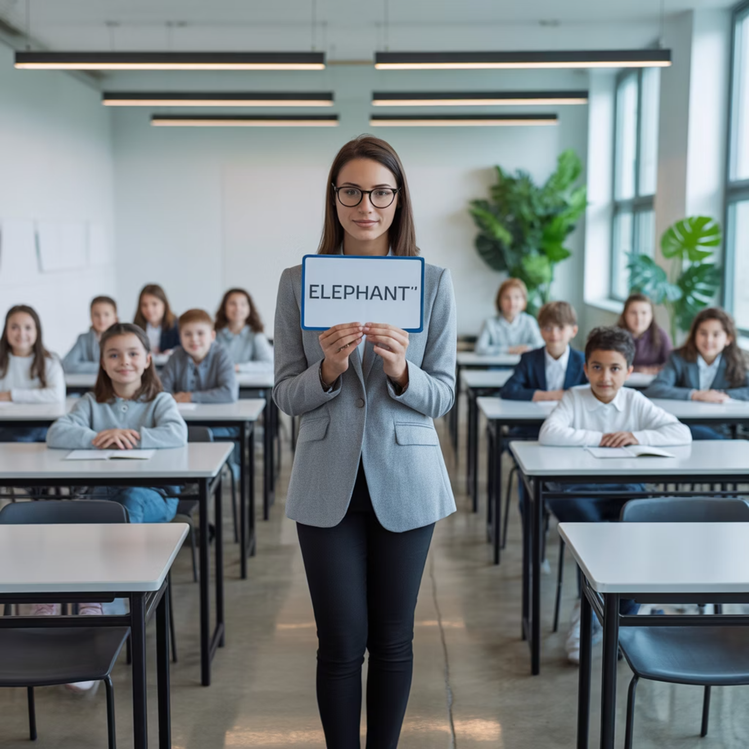
Supervised Learning: Learning with a Teacher
How it works:
The computer learns from examples that have correct answers
Like a teacher giving homework with solutions
The computer guesses, checks if it's right, and gets better
Cool example: Teaching a computer to recognize cats by showing thousands of pictures labeled "cat" or "not cat" until it becomes an expert!

Slide 4
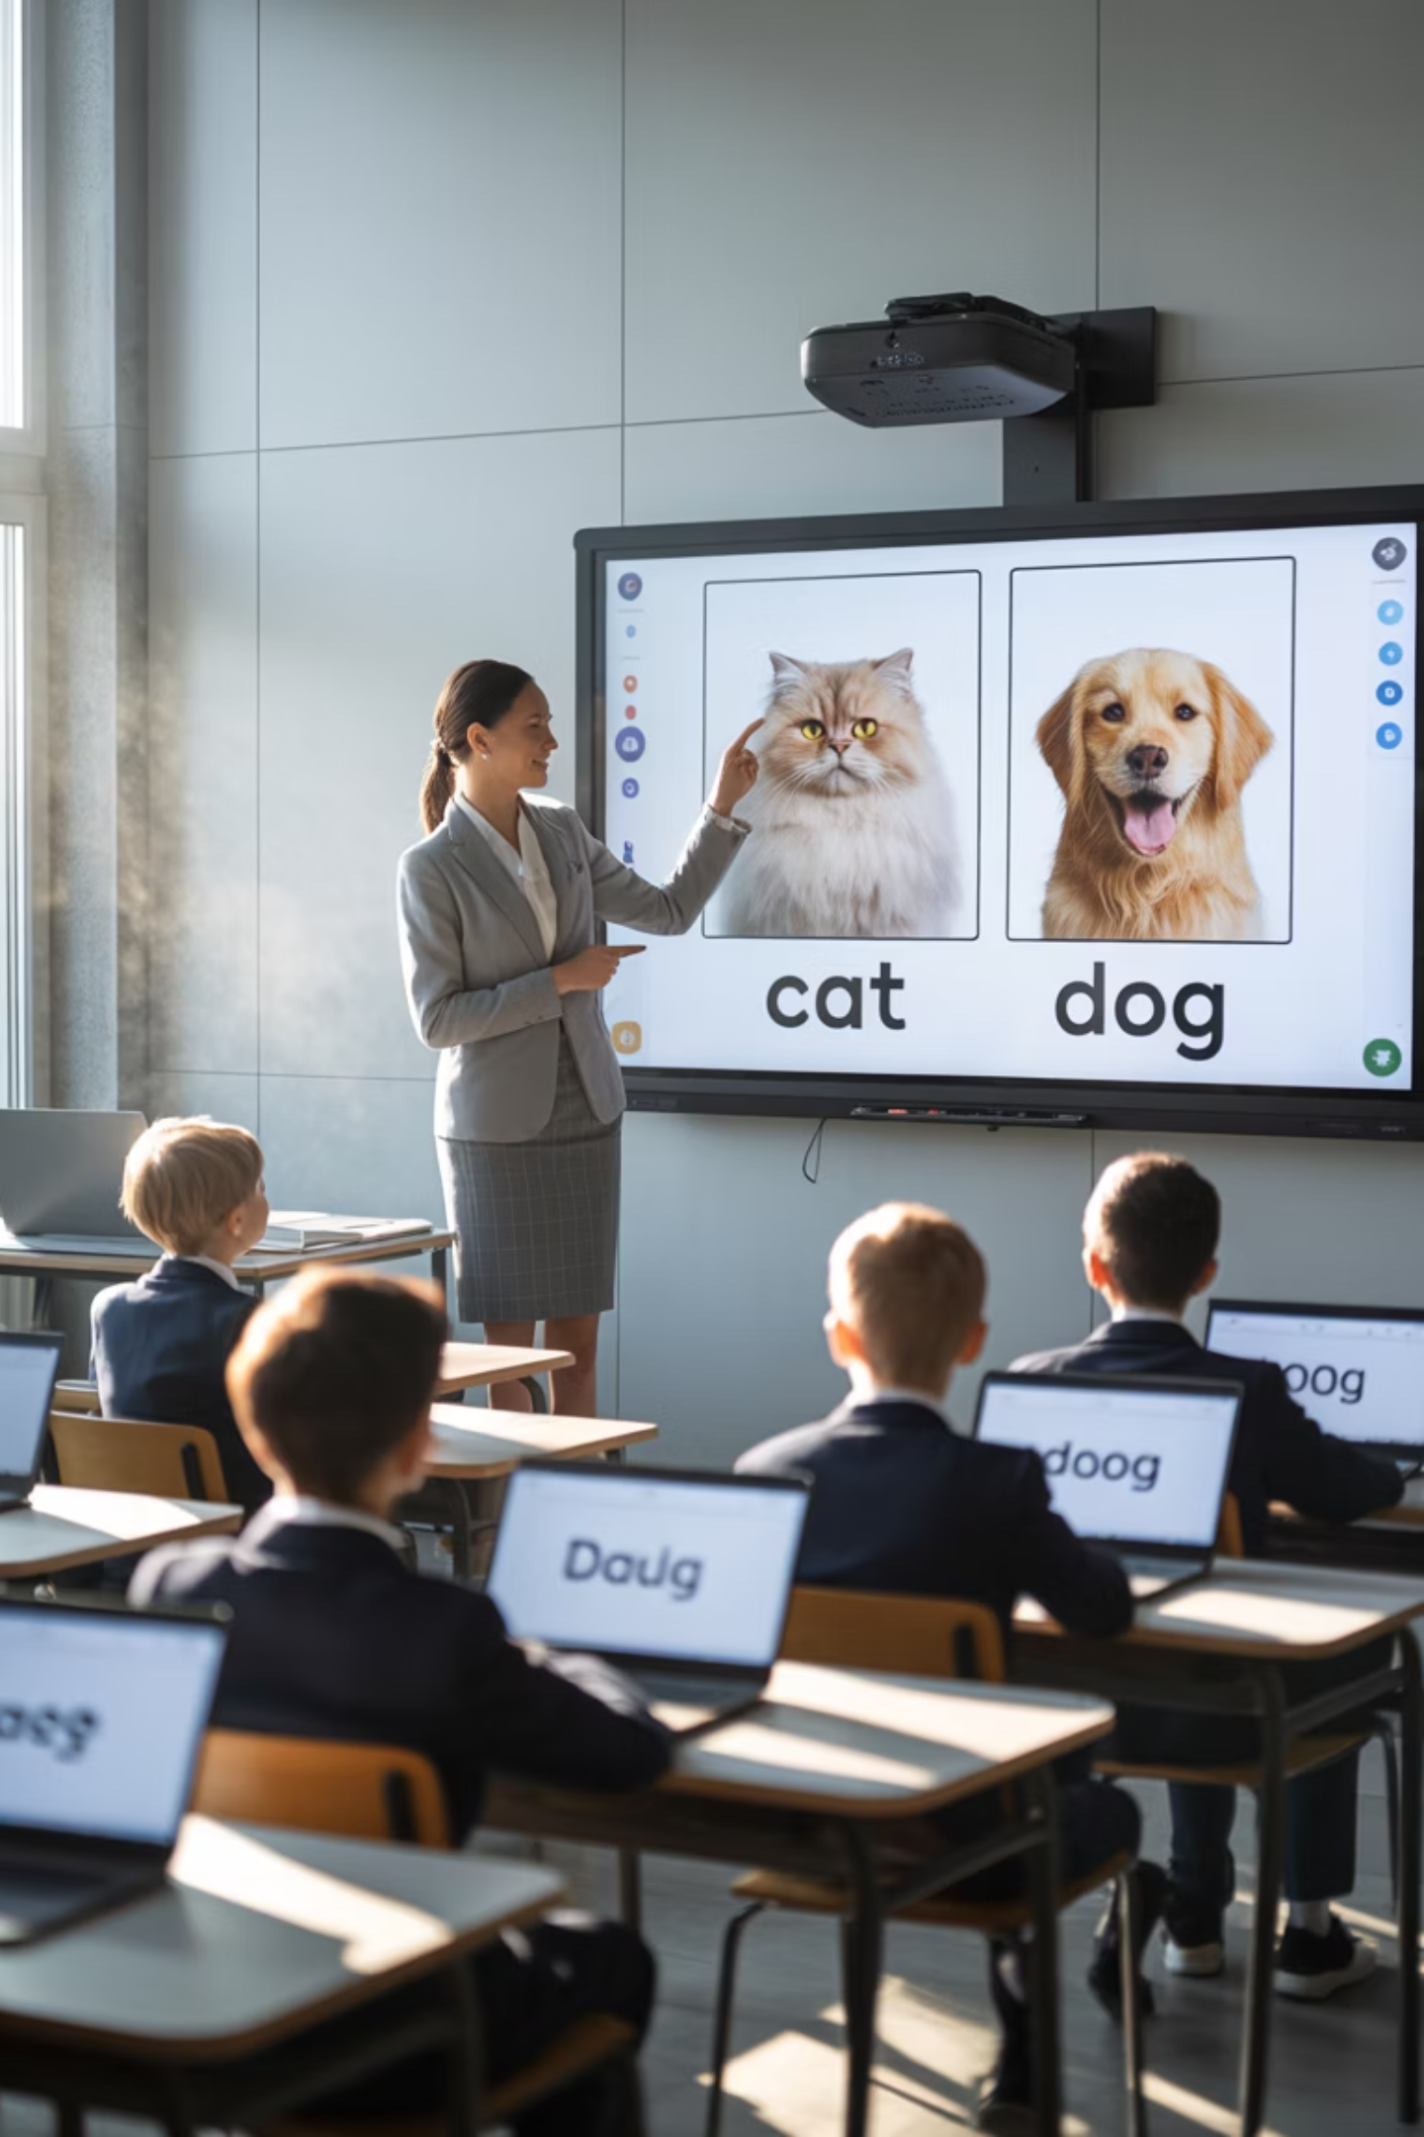
Supervised Learning: Learning with a Teacher
Just like in your classroom, supervised learning needs a teacher to provide the right answers. The computer studies these examples until it can make accurate predictions on its own!

Slide 5



Unsupervised Learning: Finding Patterns on Its Own
No Labels Needed
Pattern Detective
Real Example
The computer gets data but no answers or labels to guide it.
It looks for hidden patterns and groups things that seem similar.
Sorting your music into playlists by style without knowing the genres beforehand.

Slide 6
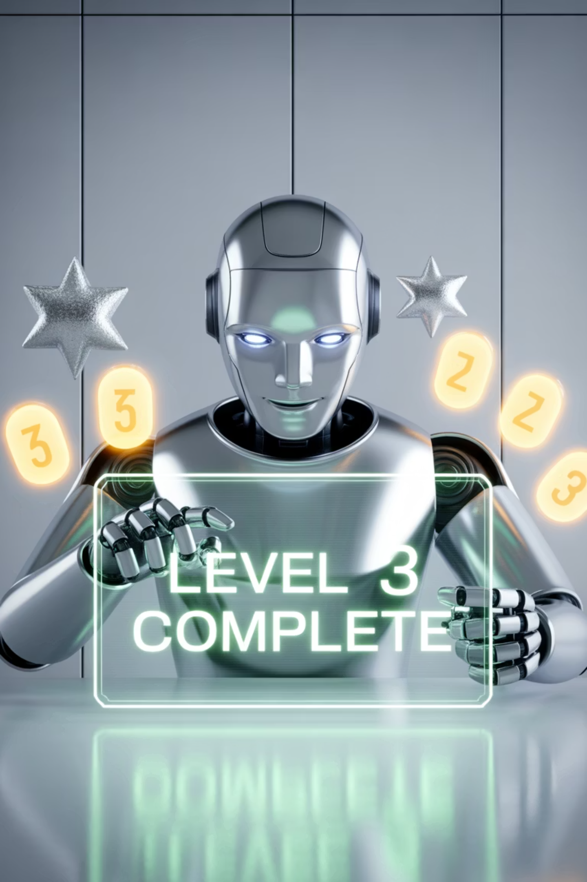
Reinforcement Learning: Learning by Trying and Getting Rewards
Think of it like playing your favorite video game - you try different moves, see what works, and get better each time you play!
01
02
Try an Action
Get Feedback
The computer makes a choice or move
It receives rewards for good moves or penalties for bad ones
03
Learn and Improve
The computer remembers what worked and tries to do better next time

Slide 7

Reinforcement Learning
Learning by Rewards
Just like how you learned to ride a bike by practicing and celebrating small wins, robots learn to walk by getting rewards for each successful step!

Slide 8
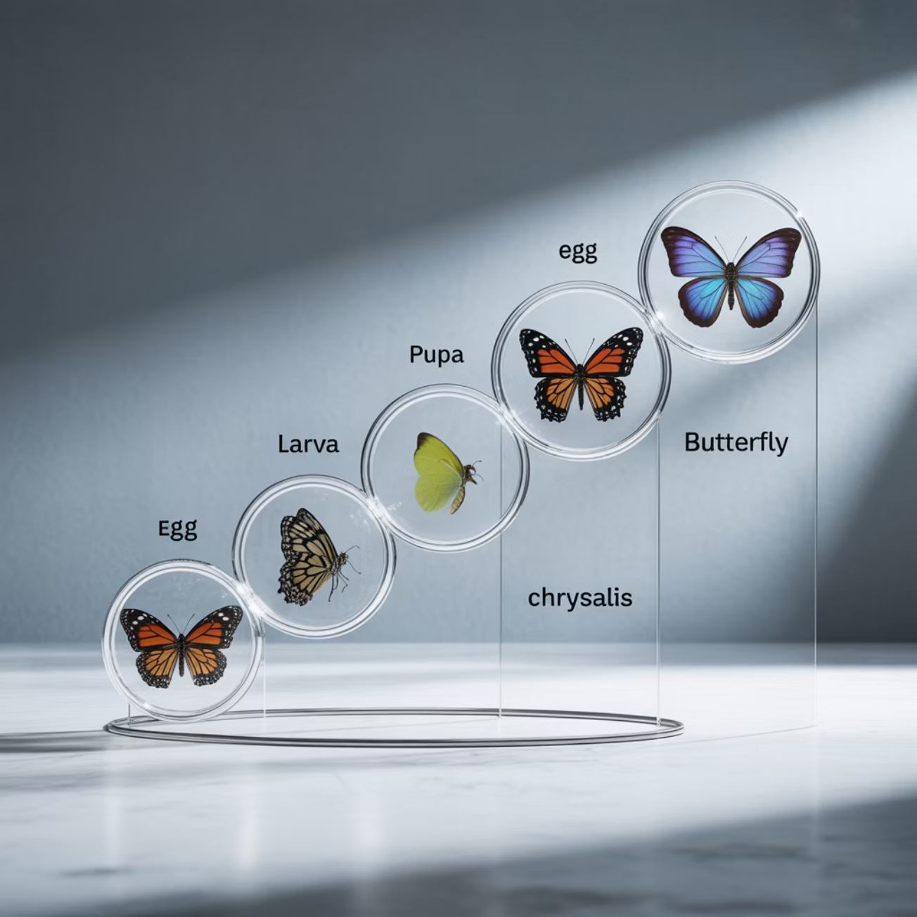



Evolutionary Learning: Learning Like Nature Does
Inspired by how animals evolve and adapt over millions of years, this type of learning is pretty amazing!
Generate Ideas
Create many different solutions
Test & Select
Keep only the best performing ones
Improve
Make the next generation even better
Cool example: Designing better airplane wings by testing thousands of designs and keeping the ones that fly the best!

Slide 9

Why Does Machine Learning Matter?
It's Already in Your Life
Future Career Opportunities
Problem Solving Power
Voice assistants like Siri, recommendation systems on YouTube, filters on social media, and even some video games use machine learning every day.
Understanding these concepts opens doors to exciting careers in technology, robotics, game design, and so much more!
These techniques help solve real-world challenges like climate change, medical research, and space exploration.

Slide 10
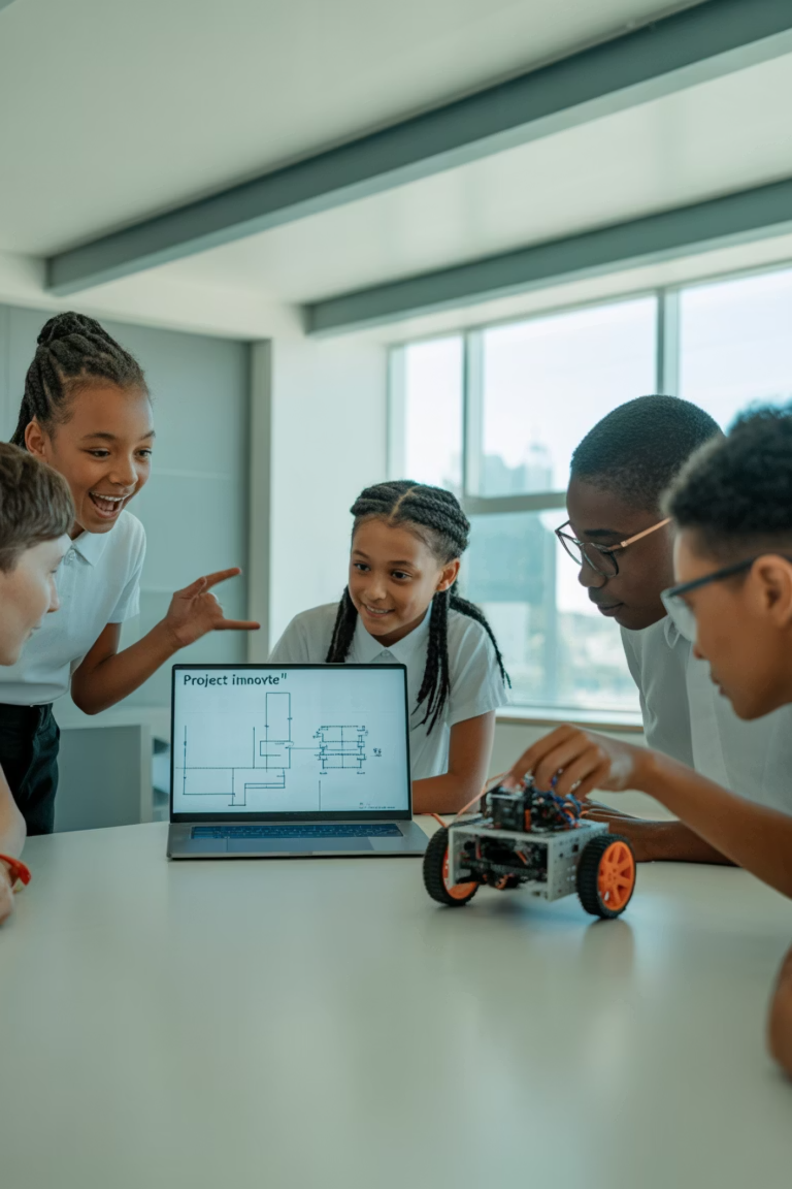
Ready to Explore Machine Learning?
Remember the Big Four:
Supervised = learning with answers
Unsupervised = finding patterns alone
Reinforcement = learning by rewards
Evolutionary = learning by improvement
Machine learning is like teaching computers to be curious and smart—just like you! The future is full of possibilities when humans and smart computers work together.

